Slide 1



PHISHING ATTACKS
MADE BY MOHAMED CHAWKI FRIGUI

Slide 2
PLAN
1
4
Understanding Social Engineering Tactics
Introduction
2
Recognizing Phishing Emails
5
Best Practices for Protection
3
Identifying Fake Websites
6
Interactive Quiz
7
Conclusion

Slide 3




1
Introduction
INTRODUCTION
This presentation raises awareness of phishing attacks, teaches how to identify fraudulent emails and websites, deciphers social engineering tactics, and offers tips for protecting yourself. Real-life examples and an interactive quiz reinforce the learning.

Slide 4
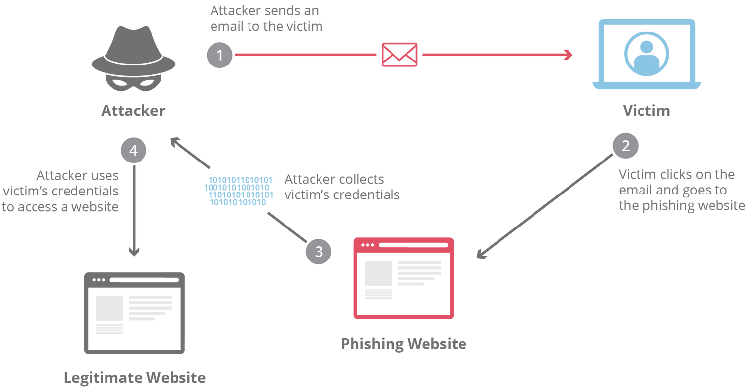
2
Recognizing Phishing Emails
Phishing emails are designed to look like legitimate communications, but they often contain telltale clues:
RECOGNIZING PHISHING EMAILS

Slide 5

2
Recognizing Phishing Emails
Suspicious sender: Check the email address. For example, an email from "support@paypa1.com" (with a "1" instead of "l") is suspicious.
RECOGNIZING PHISHING EMAILS

Slide 6
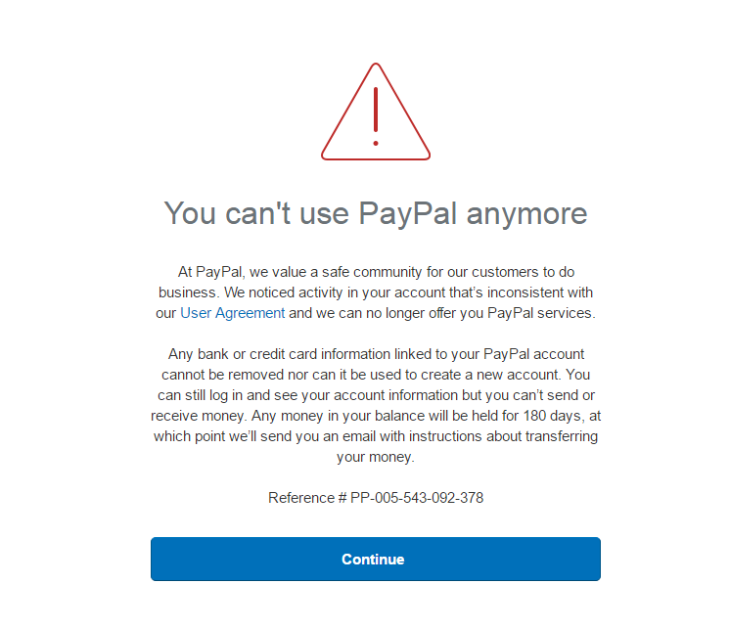
2
Recognizing Phishing Emails
Excessive urgency: Messages like "Your account will be suspended in 24 hours!" encourage people to act without thinking.
RECOGNIZING PHISHING EMAILS

Slide 7
2
Recognizing Phishing Emails
Questionable links: Hover over links (without clicking) to see the actual URL. For example, a link displayed as "www.banque.fr" may redirect to "www.banq-fake.ru."
RECOGNIZING PHISHING EMAILS

Slide 8
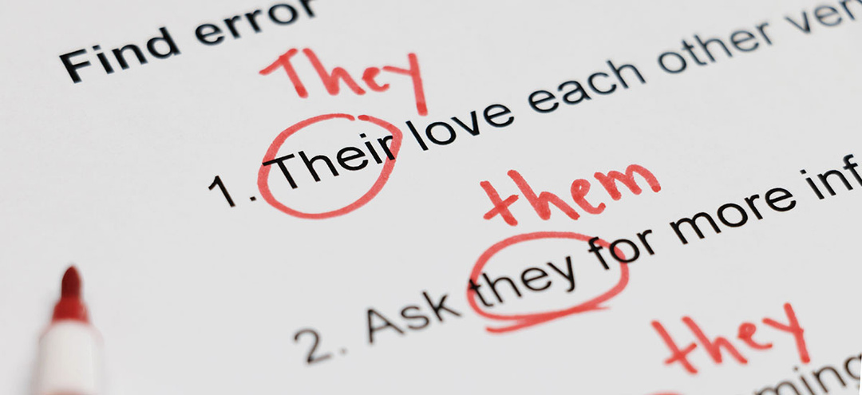
2
Recognizing Phishing Emails
Spelling mistakes: Legitimate emails are rarely riddled with errors.
RECOGNIZING PHISHING EMAILS

Slide 9
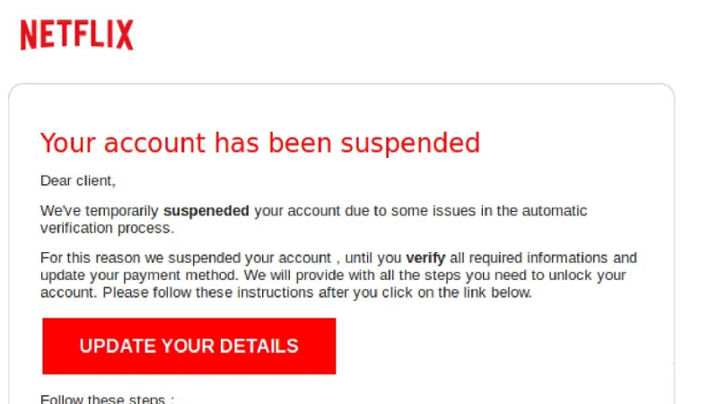
2
Recognizing Phishing Emails
Concrete example:
RECOGNIZING PHISHING EMAILS
This email uses an urgent tone and a questionable link to encourage sharing of personal information.

Slide 10
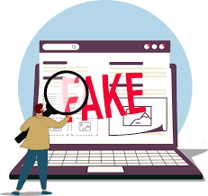
3
Identifying Fake Websites
Phishing sites mimic legitimate sites
to steal your information.
Here's how to spot them:
IDENTIFYING FAKE WEBSITES

Slide 11
3
Identifying Fake Websites
Suspicious URL: Check the website address. For example, "www.g00gle.com" or "www.amazon-login.ru" are fake.
No HTTPS: Legitimate sites use HTTPS (padlock in the address bar).
Unusual design: Blurry logos, strange fonts, or inconsistent layouts are red flags.
Request for sensitive information: A site suddenly asking for your password or banking information is suspicious.
IDENTIFYING FAKE WEBSITES

Slide 12
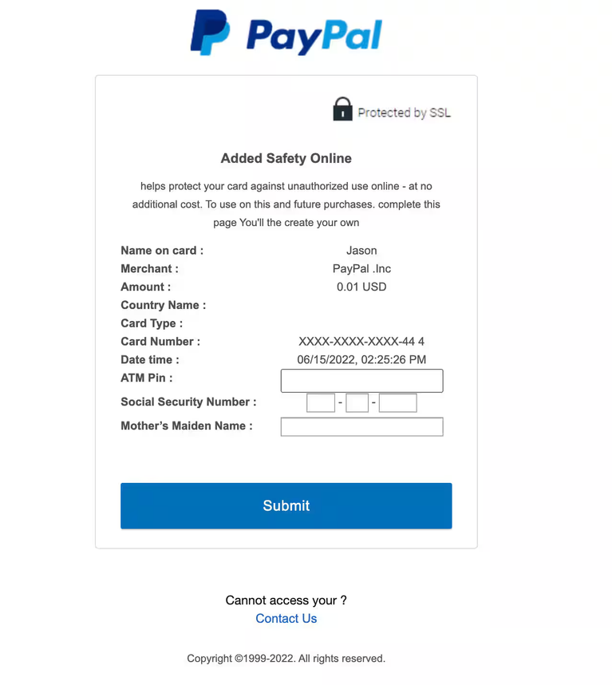
3
Identifying Fake Websites
Concrete example:
A site imitating PayPal asks you to "verify your account"
by entering your password and card number. The URL is "www.paypal-login.co" and there is no HTTPS padlock.
IDENTIFYING FAKE WEBSITES

Slide 13

4
Understanding Social Engineering Tactics
UNDERSTANDING SOCIAL ENGINEERING TACTICS
Attackers exploit human psychology to manipulate their victims. Here are common tactics:

Slide 14

4
Understanding Social Engineering Tactics
UNDERSTANDING SOCIAL ENGINEERING TACTICS
Fear and Urgency: Create a sense of panic to encourage rapid action (e.g., "Your account is compromised!").

Slide 15

4
Understanding Social Engineering Tactics
UNDERSTANDING SOCIAL ENGINEERING TACTICS
Trust Fraud: Impersonate an authority (bank, boss, IT department) to gain your trust.

Slide 16
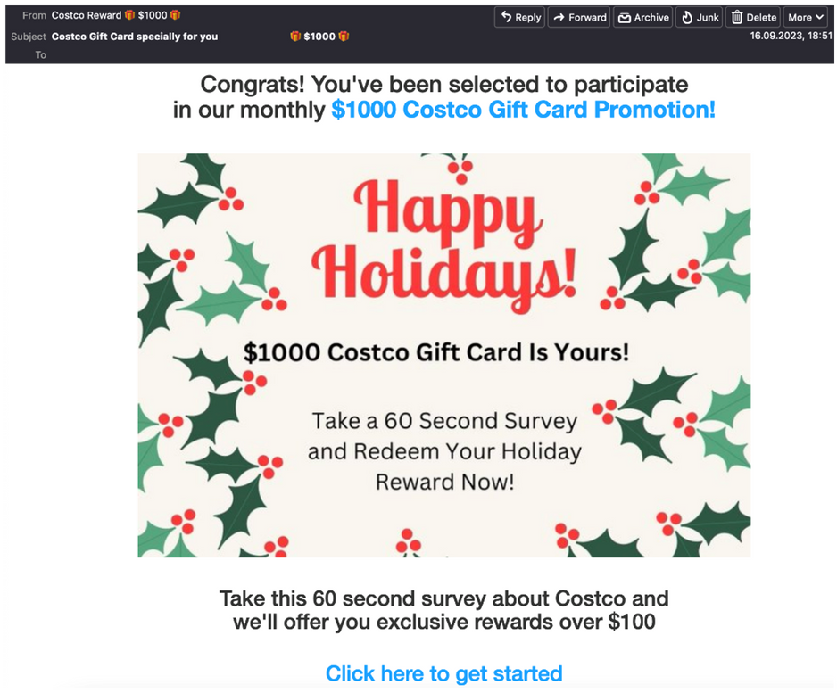
4
Understanding Social Engineering Tactics
UNDERSTANDING SOCIAL ENGINEERING TACTICS
Curiosity or Greed: Promise rewards, such as free gift cards, to attract victims.

Slide 17
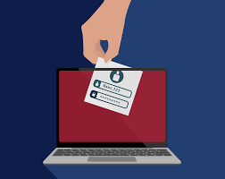
4
Understanding Social Engineering Tactics
UNDERSTANDING SOCIAL ENGINEERING TACTICS
Personalization: Use personal information (obtained through data breaches) to make
the message seem credible.

Slide 18
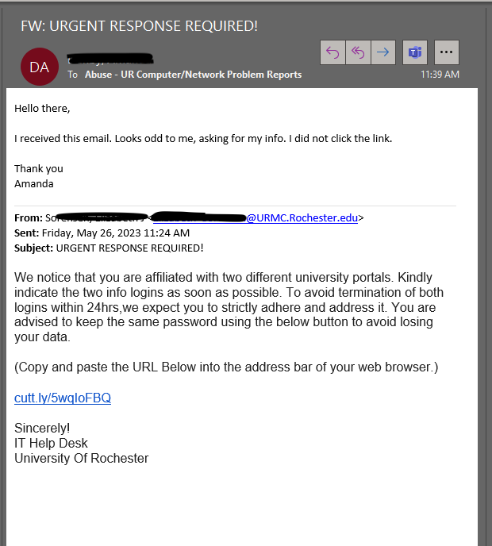
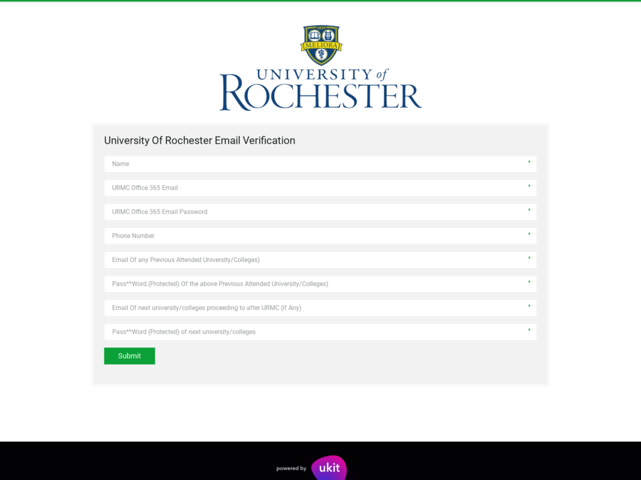
4
Understanding Social Engineering Tactics
Concrete example:
UNDERSTANDING SOCIAL ENGINEERING TACTICS

Slide 19

5
Best Practices for Protection
BEST PRACTICES FOR PROTECTION
Follow these tips to minimize risks:

Slide 20

5
Best Practices for Protection
BEST PRACTICES FOR PROTECTION
Verify senders: Carefully examine the email address before replying or clicking.

Slide 21
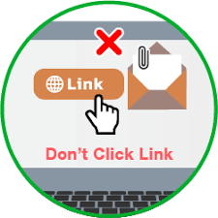
5
Best Practices for Protection
BEST PRACTICES FOR PROTECTION
Don't click on suspicious links: Go directly to official websites through your browser.

Slide 22
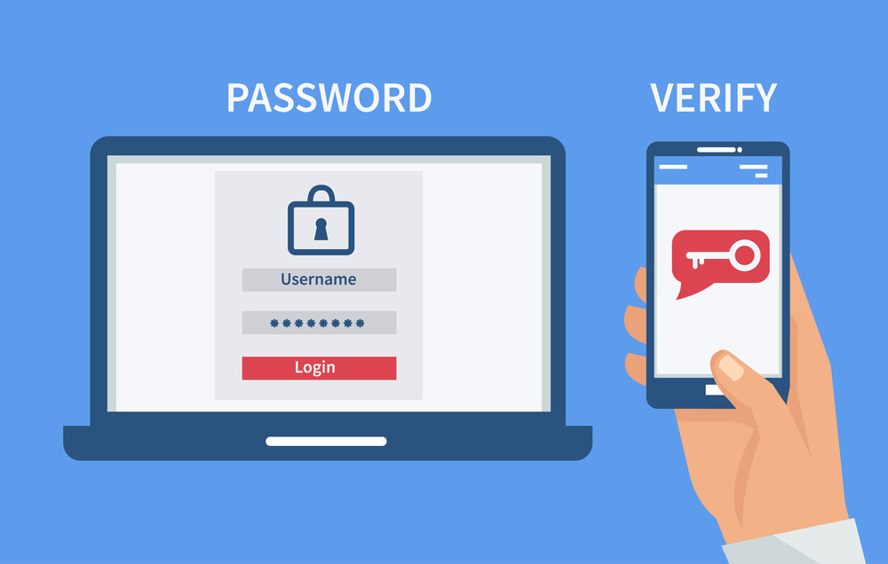
5
Best Practices for Protection
BEST PRACTICES FOR PROTECTION
Use two-factor authentication (2FA): Add a layer of security to your accounts.

Slide 23

5
Best Practices for Protection
BEST PRACTICES FOR PROTECTION
Beware of urgent requests: Take the time to verify before acting.

Slide 24
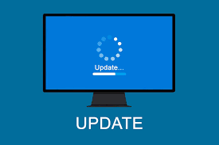
5
Best Practices for Protection
BEST PRACTICES FOR PROTECTION
Update your software: Security patches protect against vulnerabilities exploited by attackers.

Slide 25

5
Best Practices for Protection
BEST PRACTICES FOR PROTECTION
Report attempts: Inform your IT department or the relevant platform of suspicious emails.

Slide 26

6
Interactive Quiz
INTERACTIVE QUIZ

Slide 27
6
Interactive Quiz
What is a common sign of a phishing email?
An official email address
An urgent request for action
A professional, flawless design

Slide 28

6
Interactive Quiz
Correct! Nice job, move on to thenext question.
Next Question

Slide 29
6
Interactive Quiz
How do I check if a website is secure?
Check for HTTPS and a padlock
Click on all links to test
Enter your credentials to see

Slide 30
6
Interactive Quiz
Correct! Nice job, move on to thenext question.
Next Question

Slide 31
6
Interactive Quiz
What social engineering tactic is commonly used?
Offering software updates
Creating a sense of urgency
Sending emails without links

Slide 32
6
Interactive Quiz
Correct! Nice job, move on to thenext question.
Next Question

Slide 33

6
Interactive Quiz
Close !... But that's not right, pleasego back and try again.
Go Back

Slide 34


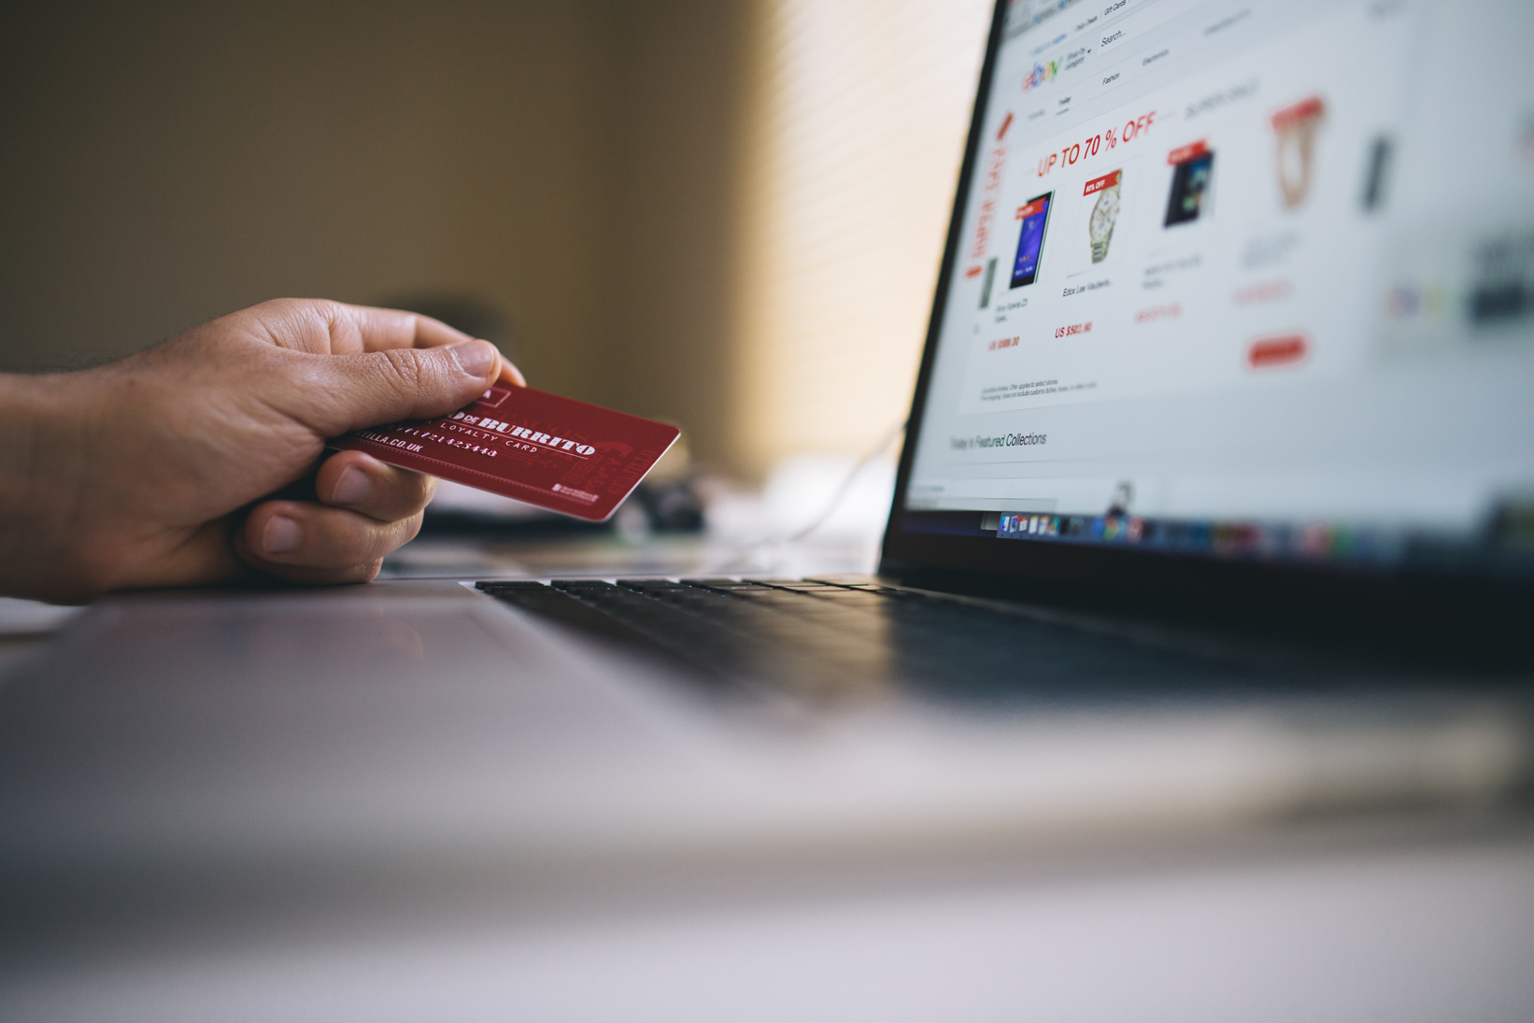
7
Conclusion
Phishing attacks exploit trust and inattention, but with the right knowledge, you can thwart them. By systematically verifying senders, avoiding suspicious links, and adopting measures like two-factor authentication, you can strengthen your online security. This module has equipped you with concrete tools to recognize and avoid these threats. Continue to remain vigilant and share these tips with others. Thank you for your attention, and browse carefully!

Slide 35
THANK YOU

